Slide 1
Partial Derivatives

Slide 2
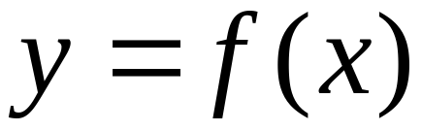
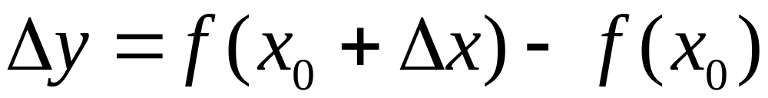
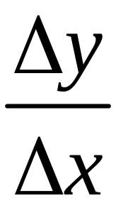
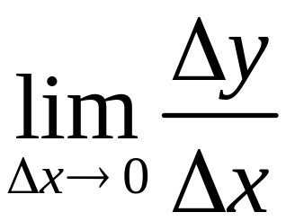
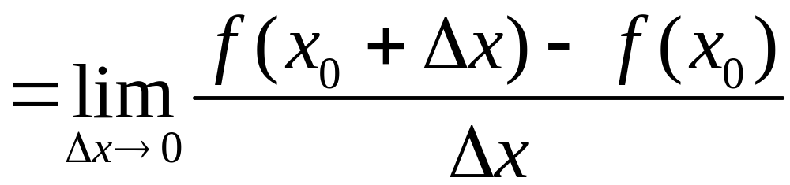
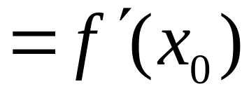
Recall

Slide 3






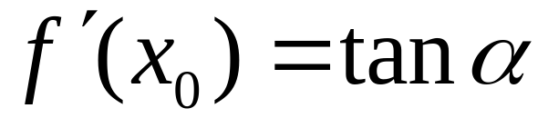
Average rate of change
Instantaneous rate of change

Slide 4
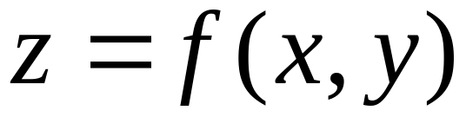
Functions of two variable
（partial increment in x ）

Slide 5
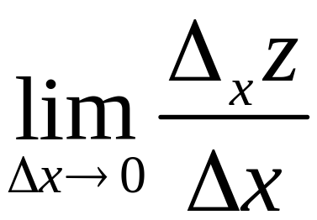
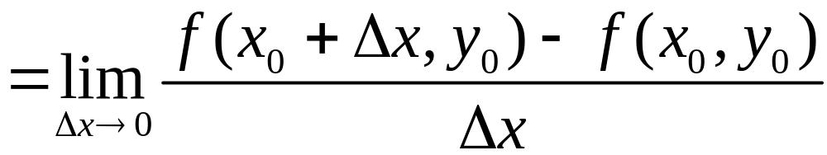
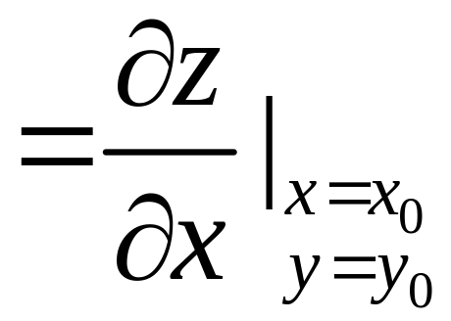
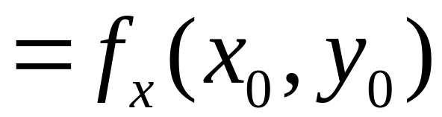
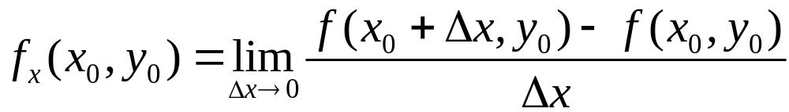
The partial derivative of f(x, y) with respect to x

Slide 6
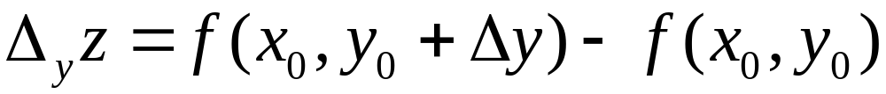

Partial derivatives
partial increment in y

Slide 7
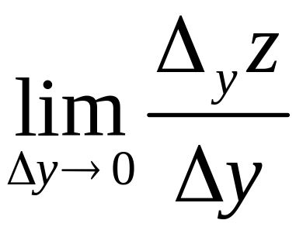
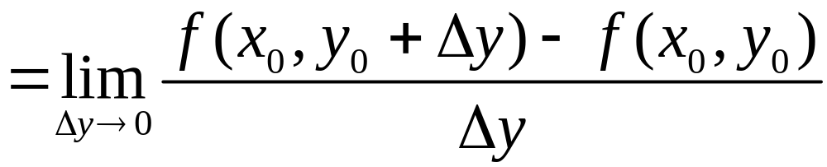
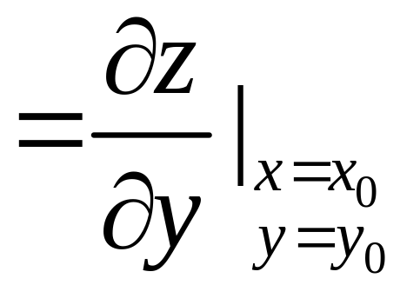
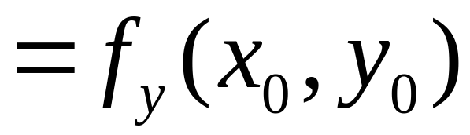
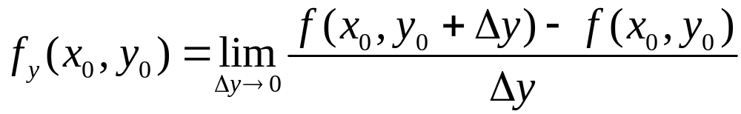
The partial derivate of f(x, y) with respect to y

Slide 8
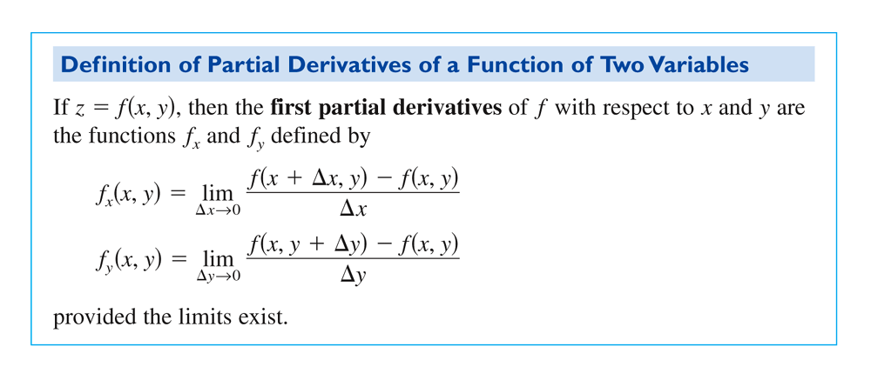

Slide 9
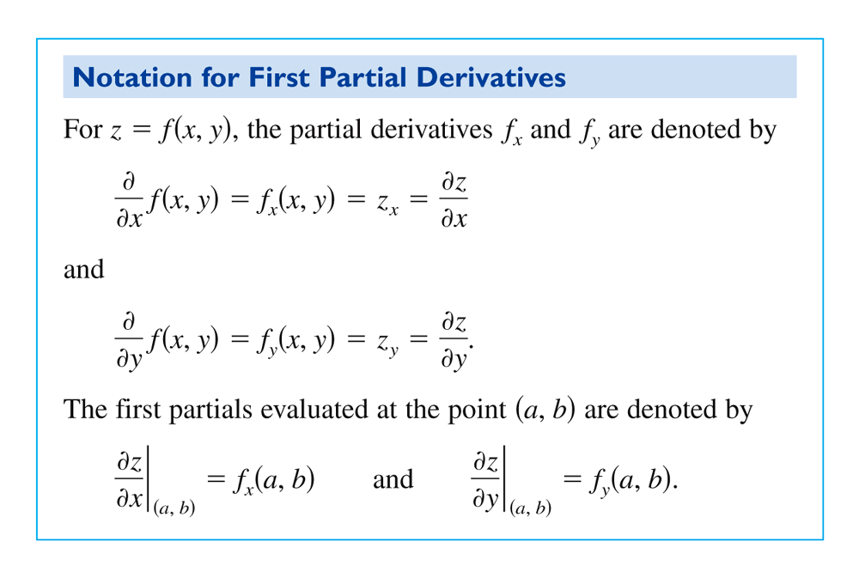

Slide 10
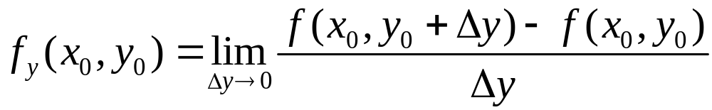
Partial derivatives: Geometric interpretation

Slide 11
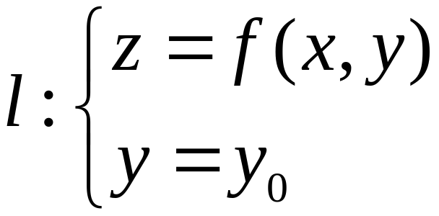
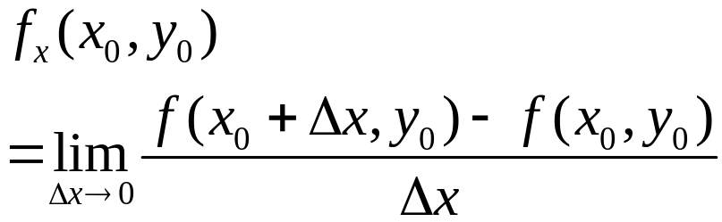
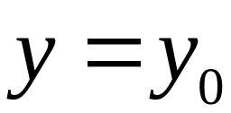
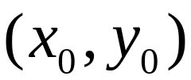
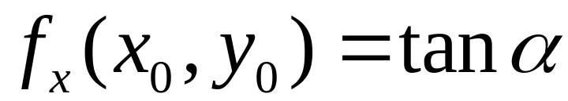

Slide 12
f_{x}(x₀, y₀) is slope of the curve
at x = x₀

Slide 13
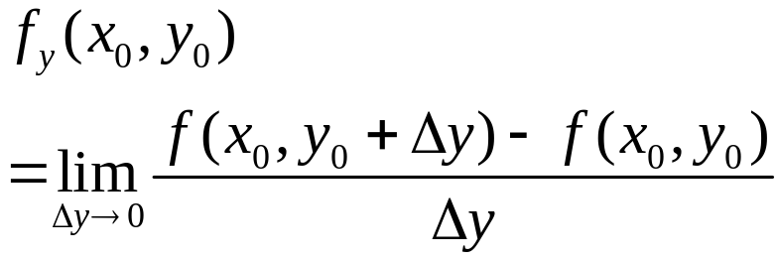
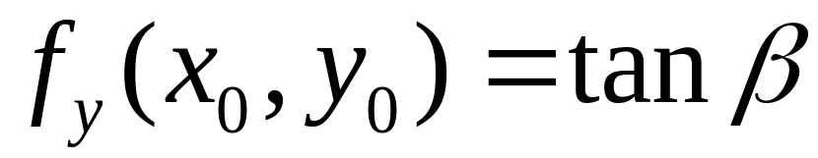

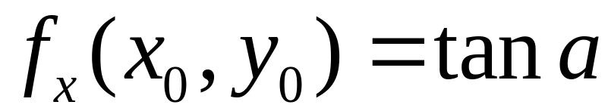
Geometric interpretation

Slide 14
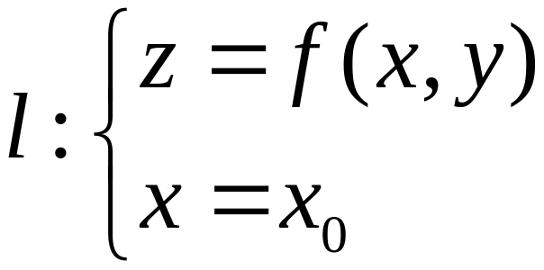
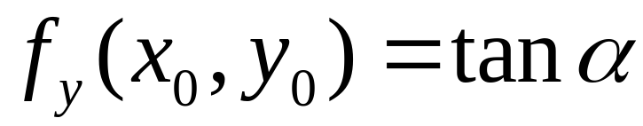
fy(x₀, y₀) is slope of the curve
at y = y0

Slide 15
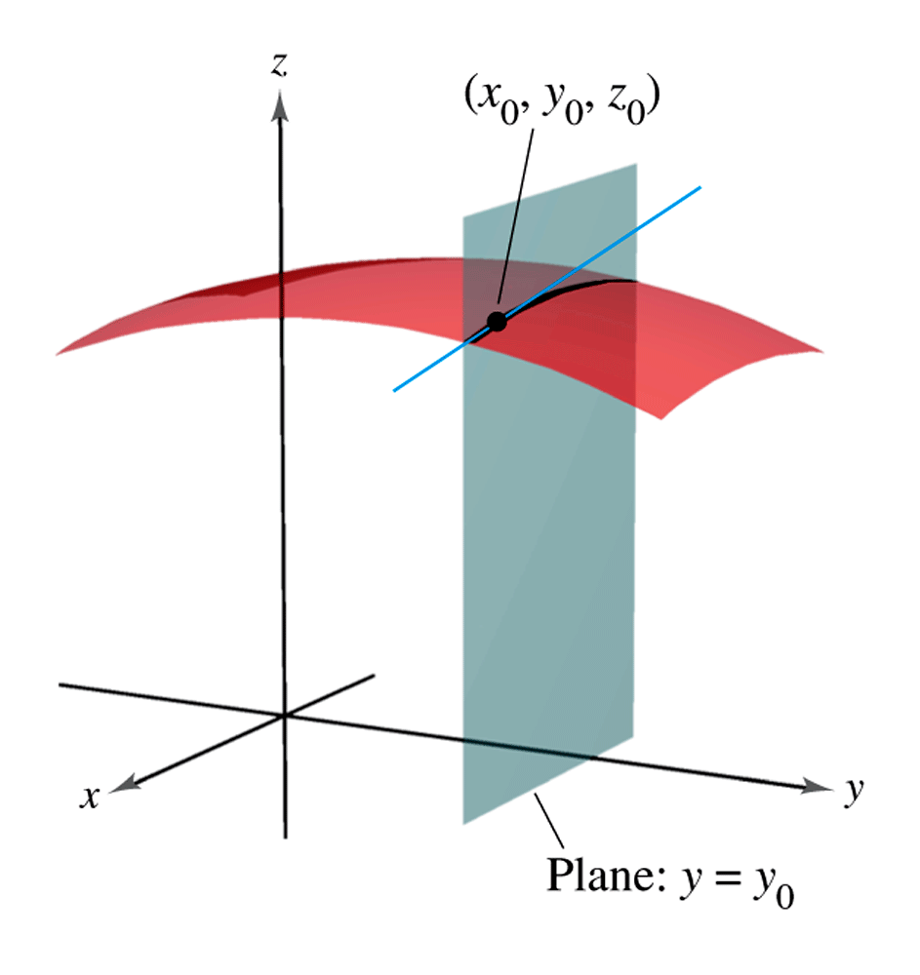
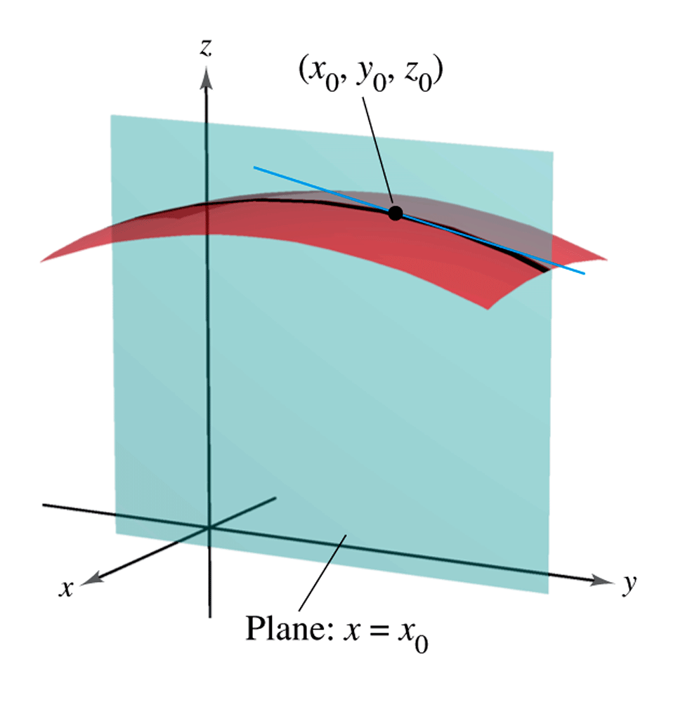

Slide 16
Investigation: Continuity and Partial derivatives
Shift the two lines upward
The partial derivatives at (x₀, y₀) still exist!
But the function is not continuous at (x₀, y₀) any more

Slide 17
So for functions of several variables
Partial derivative exists
Function is continuous

Slide 18
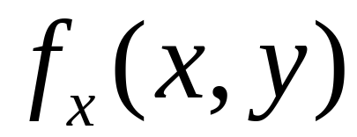
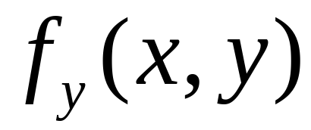
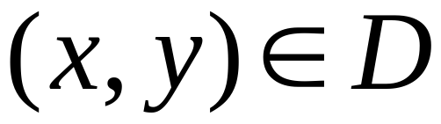
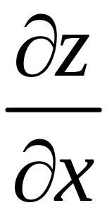
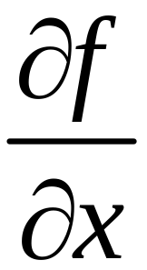
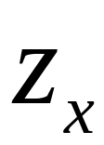
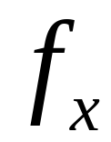
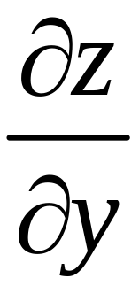
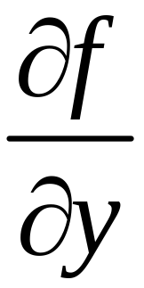
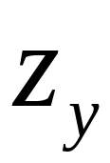
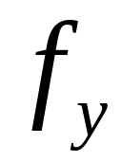
Notations

Slide 19
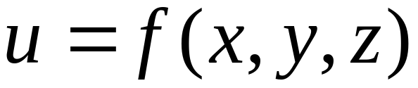
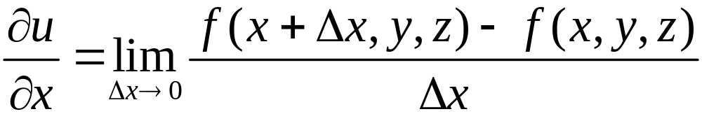
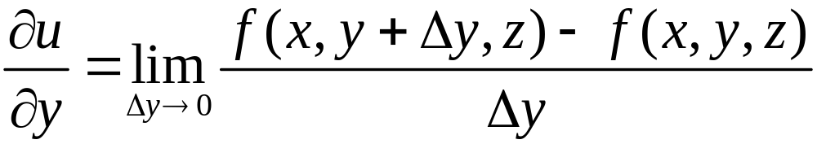
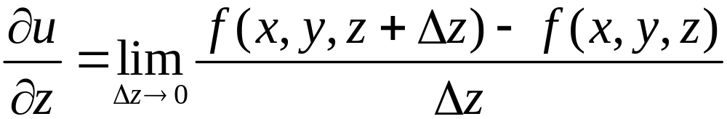
Partial derivatives of three variables

Slide 20
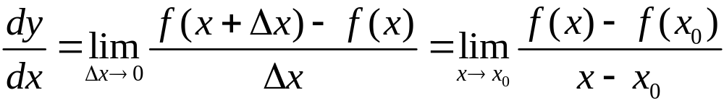

Finding partial derivative
Compare the two definitions
and

Slide 21

To find
y is a “constant”, and take derivative with respect to x

Slide 22

To find
x is a “constant”, take derivative with respect to y
All the derivative laws apply to partial derivatives

Slide 23











Example
Solution

Slide 24










Example
Find
Solution

Slide 25









NOTE
Also can plug in first
Then find derivative with respect to x

Slide 26








Example
Show that
Solution
Power rule
Derivative of an exponential function

Slide 27








so

Slide 28

Exercise:

Slide 29






Exercise
Solution

Slide 30





Slide 31








Find the partial derivatives
Solution
By symmetry

Slide 32

Proof
P: pressure，T：temperature，
V：volume

Slide 33












Temperature is not changing
The volume is not changing
The pressure is fixed

Slide 34



And so is an integrated notation, is not interpreted as a quotient.
Unlike is the quotient of two differentials dy and dx

Slide 35







Example
Find the partials of f(x, y) at (0,0)
solution
And so

Slide 36

does not exist, as we saw before
But
so，f(x, y) is not continuous at (0,0)
NOTE
For functions of several variables at a point M
Partial derivatives exist
Continuous at M
Limit of f exists

Slide 37



But for functions of one variable， at a point x₀
exists

Slide 38









Example
Show that f_{x}(0, 0) and f_{y}(0, 0) does not exist
Proof
Does not exist

Slide 39


So does f_{y}(0, 0)
Upper cone
No derivative
No partials

Slide 40
END

